Slide 1
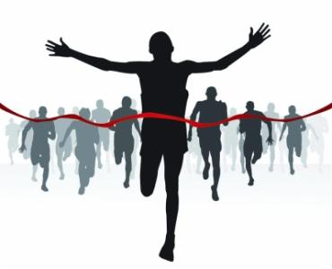
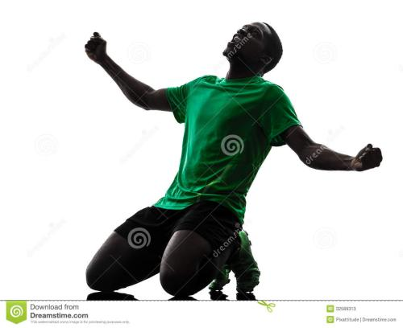
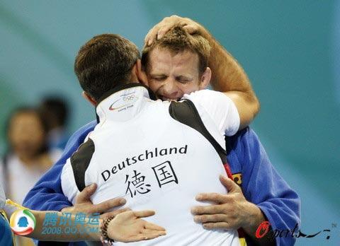
动作细节描写：
Kevin 是一个短跑运动员，在一次全国运动会上，他获得了第一名。请设计一个情节，详细描述他在获胜后的动作，重点突出他激动的心情。
——————————————————————————————————————————————————————————————————————————————————————————————————————————————————————————————————————————————————————————————————————————————————————————————————————————————————————————————————————————————————————————————————————————————

Slide 2
When he crossed the finishing line, Kevin let out with excitement. He won! He knelt down and kissed the dear track. Then he ran to his coach and expressed his thanks. His coach hugged him with watery eyes. Quite a while later, Kevin left his coach and walked to the inner track and waved to the audience, appreciating their support.

Slide 3
Crossing the finishing line, Kevin let out a roar. He won! After years of hard training, he won! He knelt down, kissing the dear track as if kissing his beloved. Then he ran to his coach , holding him tightly in his arms and repeatedly murmuring “thank you”. His coach hugged him, tears of pleasure blurring his vision. Quite a while later, Kevin calmed down and walked to the inner track, waving to the audience and appreciating their constant support .

Slide 4
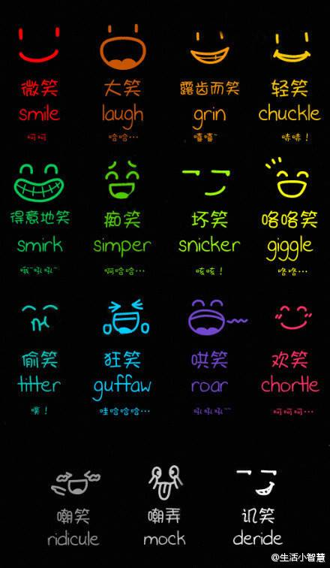
,傻笑 ,假笑 ,窃笑
,傻笑 ,哄笑 ,
放声大笑 咯咯笑
嘲笑

Slide 5
Words instead of went
bounced
dragged oneself
creep (crept)
stamped
staggered
rushed
raced
inched
limped
hurried
weaved
trudged
跳跃
拖着步子
缓慢移动，爬行,蔓延
跺脚
蹒跚
冲
快步走
谨慎移动
一瘸一拐地走
快速走
穿梭而行
步履艰难地走

Slide 6
Craft a sentence

Slide 7
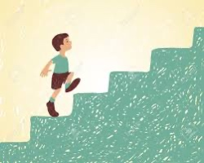
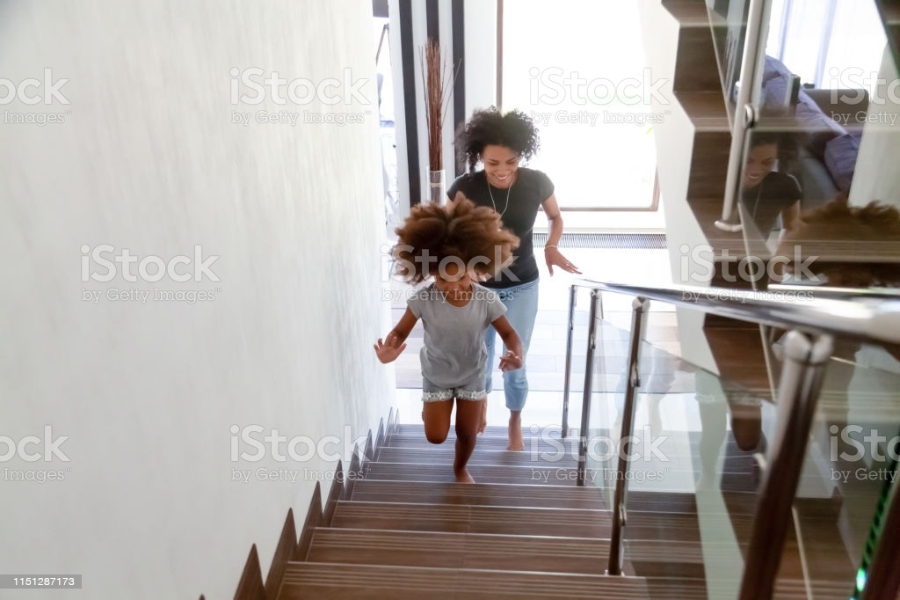
The boy went up the stairs.
excited
dependent clause
vivid verbs
adjective/description
With a gleam in his eyes, the boy raced up to the top of the staircase.

Slide 8
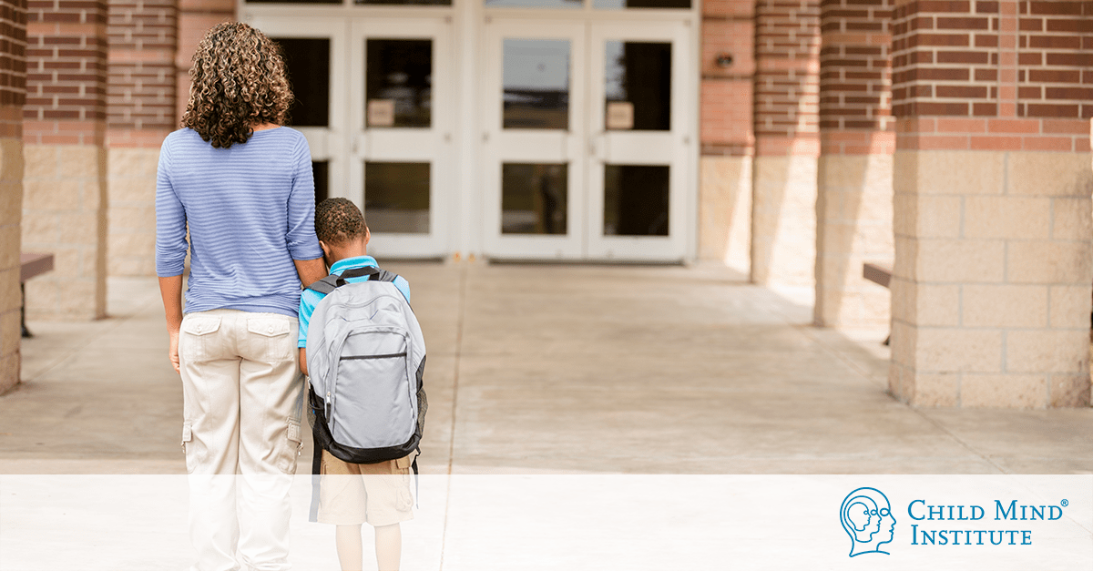
The boy went up the stairs.
reluctant/sad
Head drooping, the boy sighed and dragged himself up to the long staircase.

Slide 9
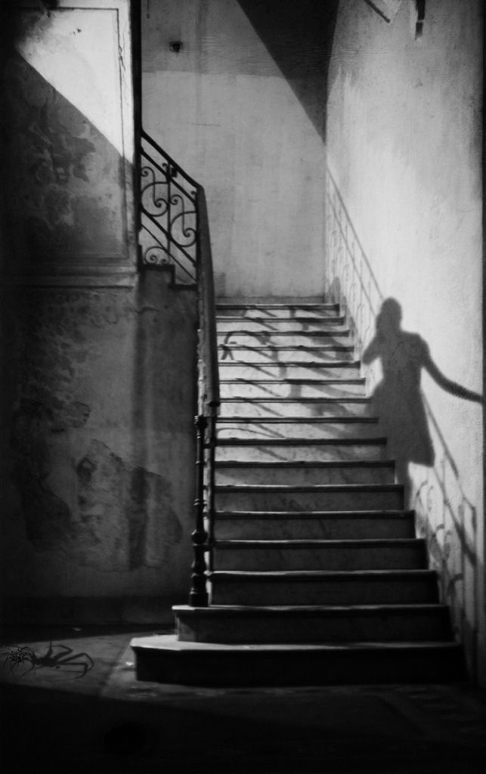
The boy went up the stairs.
scared
With a nervous glance up, the timid boy crept (慢慢移动) up the dark and shadowed stairs.

Slide 10
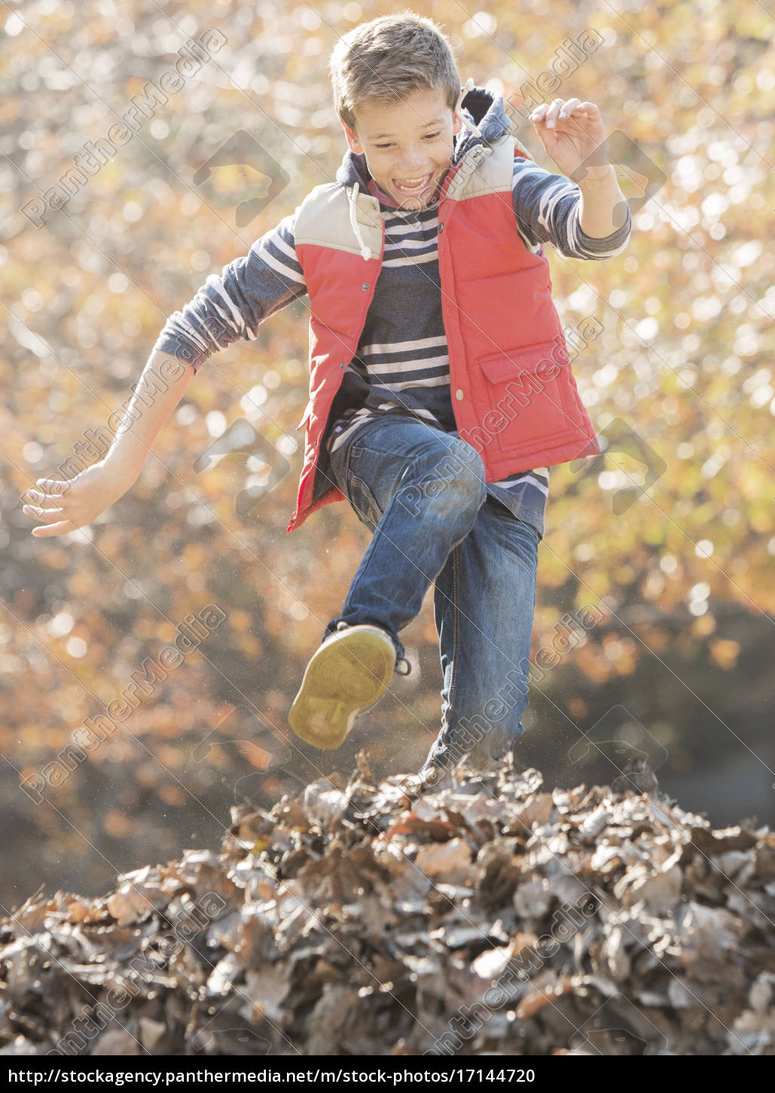
The boy went up the stairs.
cheerful/carefree
While humming（哼唱） a silly tune, the boy bounced (蹦蹦跳跳) up the stairs.

Slide 11
The boy went up the stairs.
angry
With a scowl（怒视） on his face, the boy stamped (跺脚) up each step of the staircase.

